Slide 1







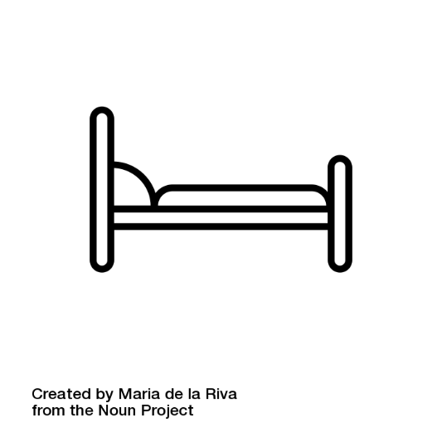
PiGraphs: Learning Interaction Snapshots from Observations
Manolis Savva Angel X. Chang Pat Hanrahan Matthew Fisher Matthias Nießner
Stanford University

Slide 2
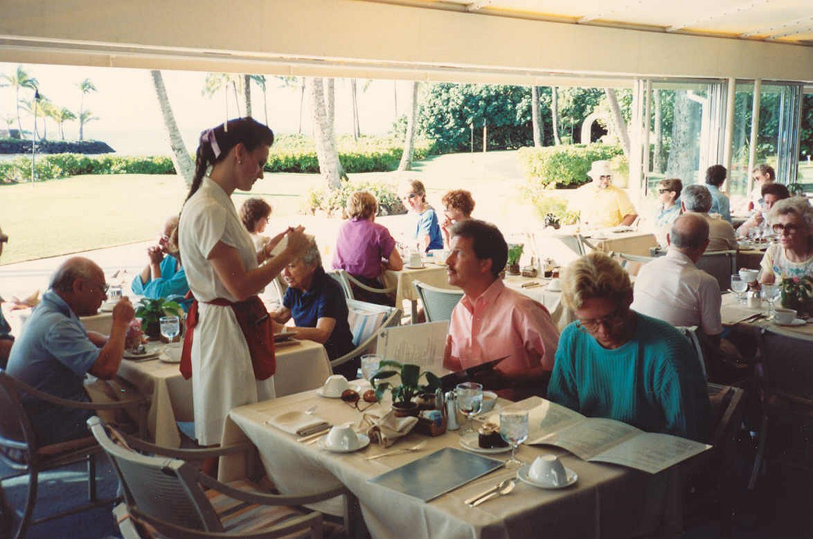
[Image copyright Alan Light, https://commons.wikimedia.org/wiki/File:Waitress_taking_an_order.jpg]

Slide 3
Can we learn by observing people in the real world?
[Image copyright EA Maxis / Electronic Arts Inc., https://www.thesims.com/news/sims-4-dine-out-news]

Slide 4
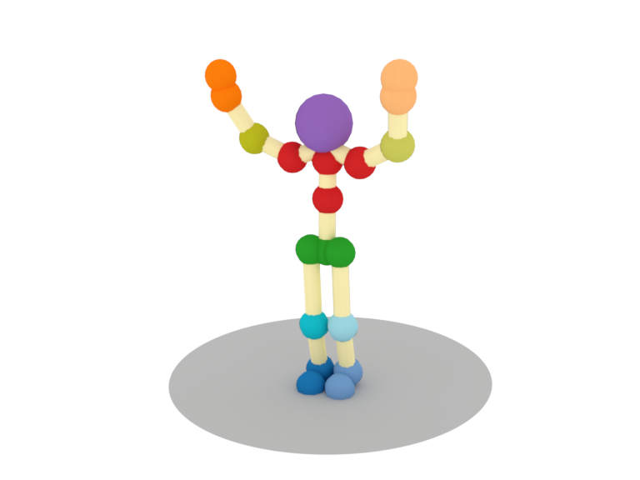
Generating snapshots
Sit on a chair and watch TV

Slide 5
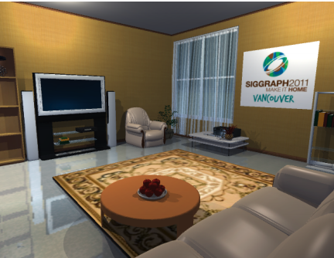
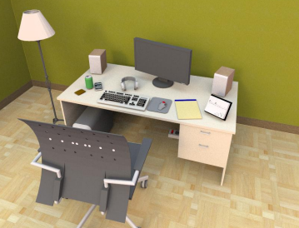
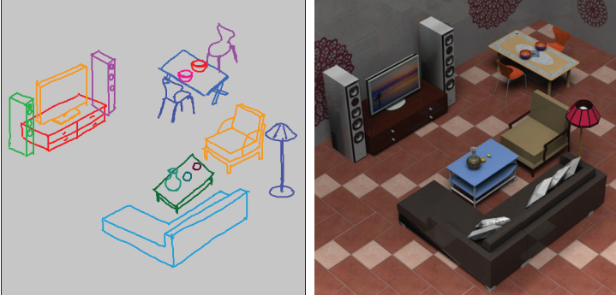
Scene synthesis
[Yu et al. 2011]
[Fisher et al. 2012]
[Xu et al. 2013]

Slide 6
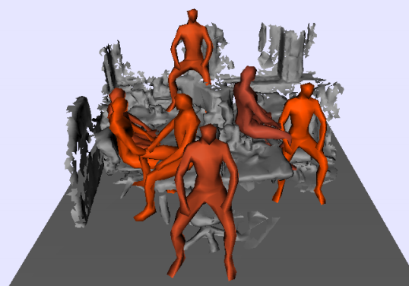
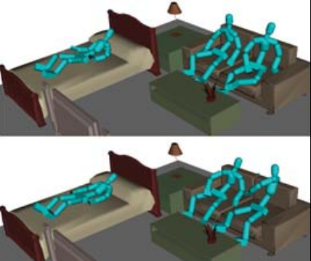
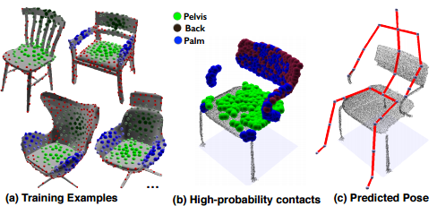
Pose synthesis
[Grabner et al. 2011]
[Kang and Lee 2014]
[Kim et al. 2014]

Slide 7
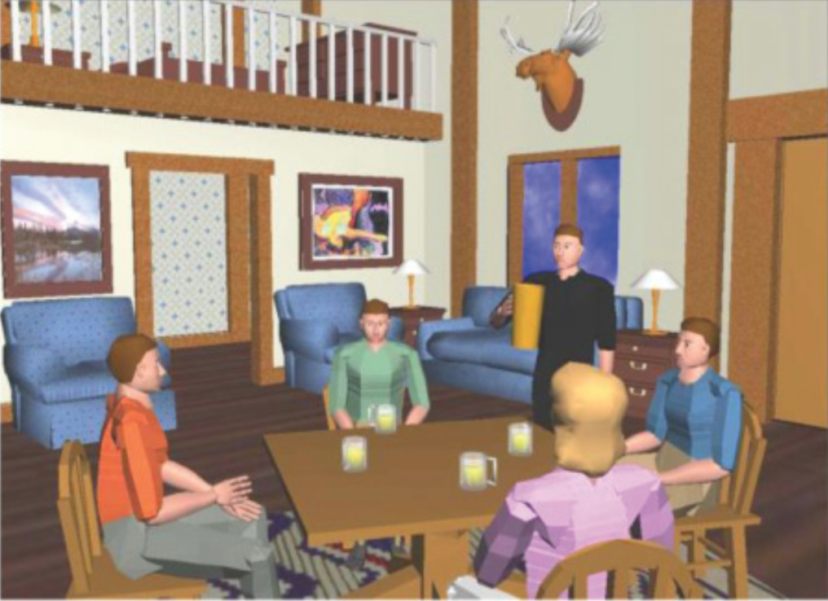
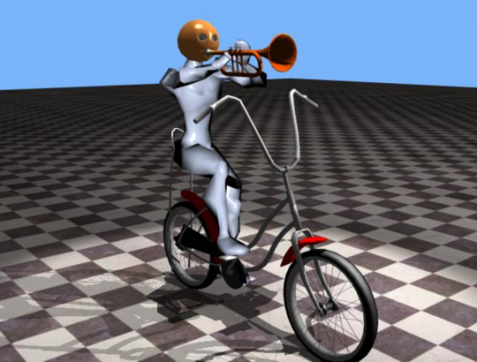
?
learn from data
[Badler et al. 1999]
Scene synthesis
Snapshot
synthesis
Pose synthesis
[Coyne and Sproat 2001]

Slide 8
Goal Generate snapshots of people and environments by learning from real-world observations
?
learn from data
[Badler et al. 1999]
Scene synthesis
Interaction
synthesis
Pose synthesis
[Coyne and Sproat 2001]

Slide 9
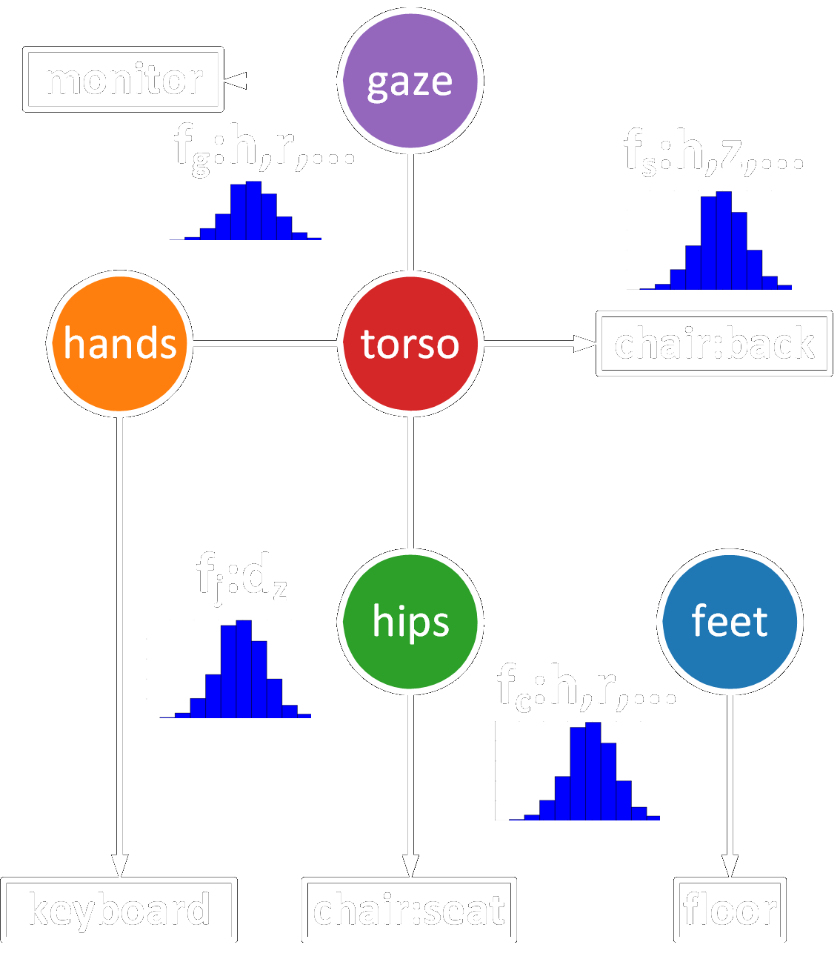
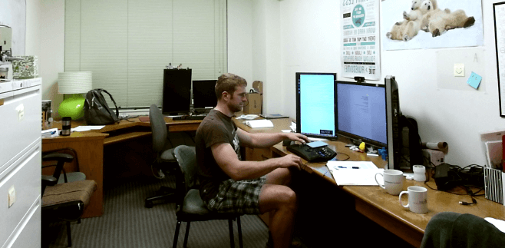
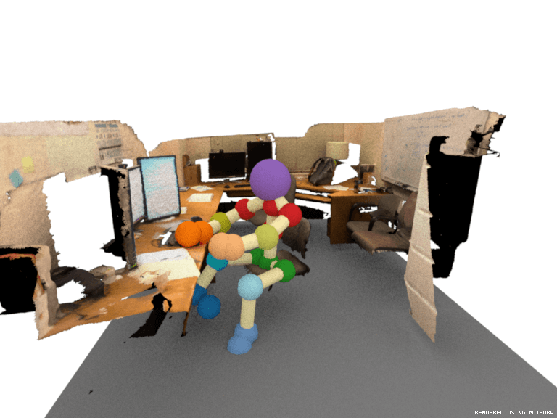
Contributions
Observe real world
Learn interactions
Generate snapshots

Slide 10
Observation
Learning
Generation

Slide 11
Observation
Learning
Generation

Slide 12
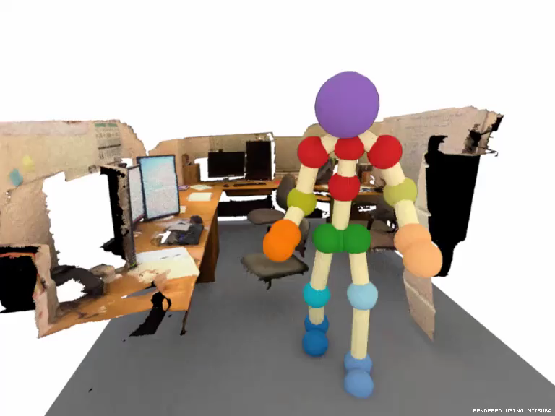
Observations from the real world

Slide 13
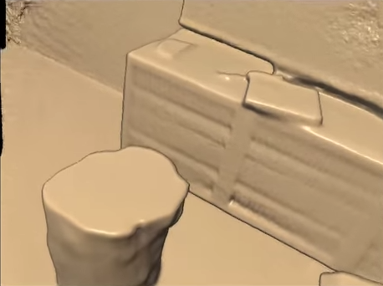
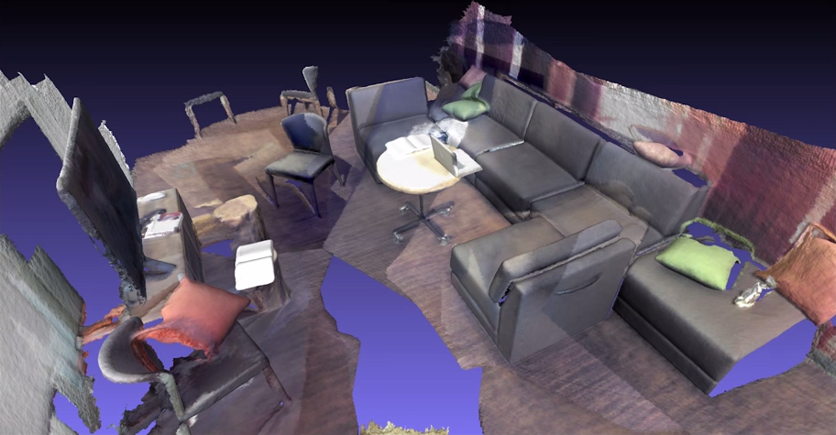
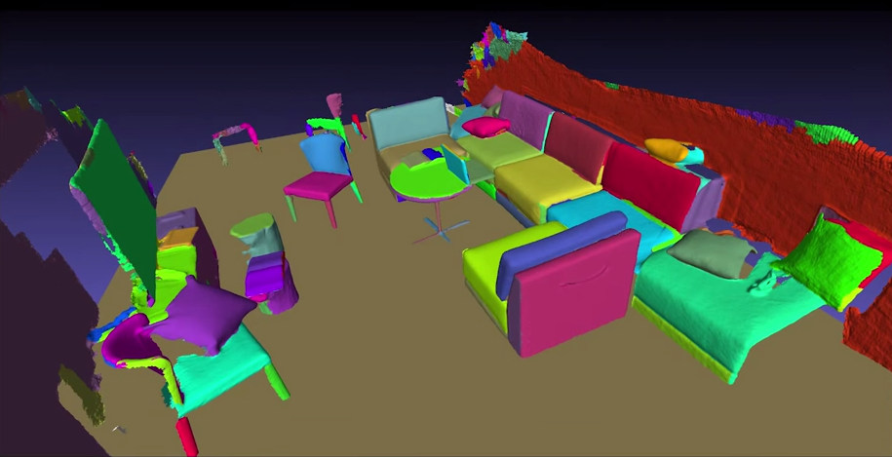
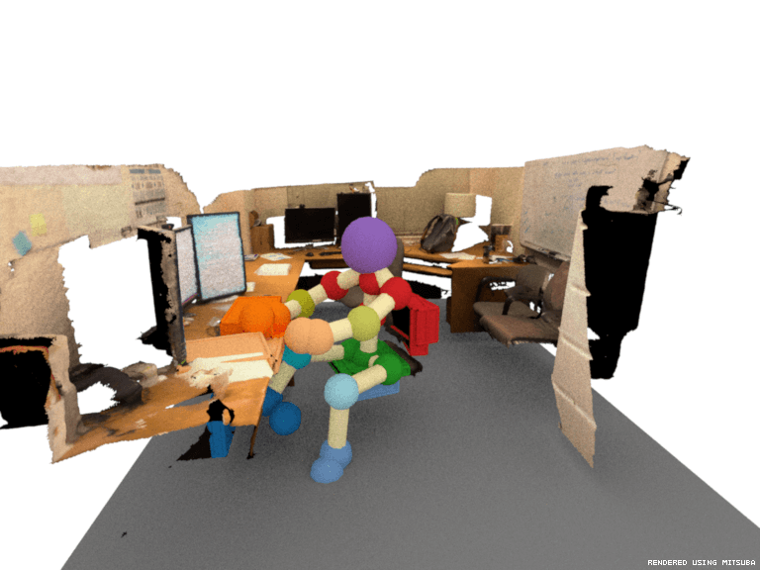
Data collection
SceneGrok [Savva et al. 2014]
RGB-D scan
Reconstruction
Object labeling
chair
RGB-D observation
Skeletal tracking
Object interactions
back contact

Slide 14
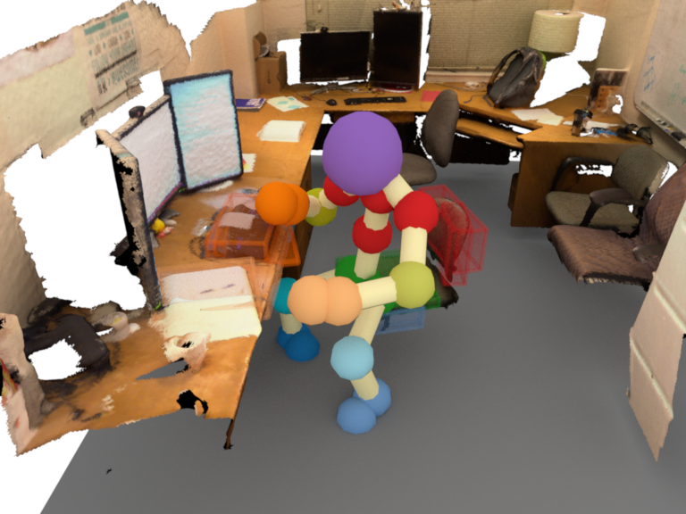
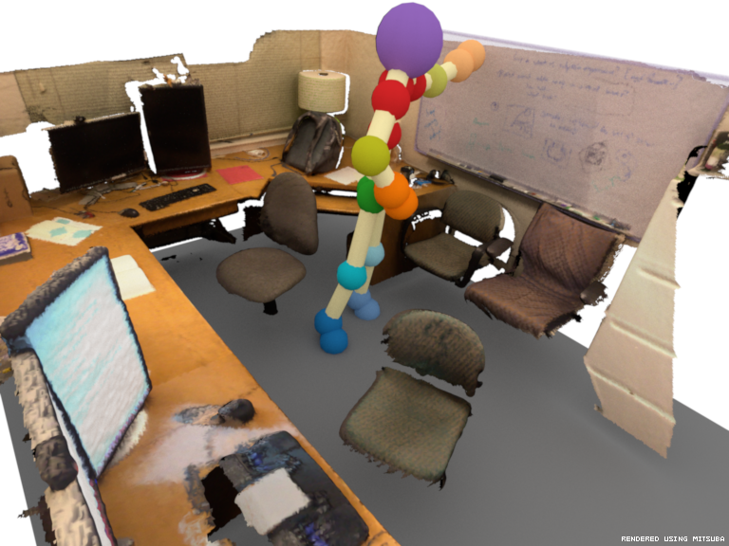
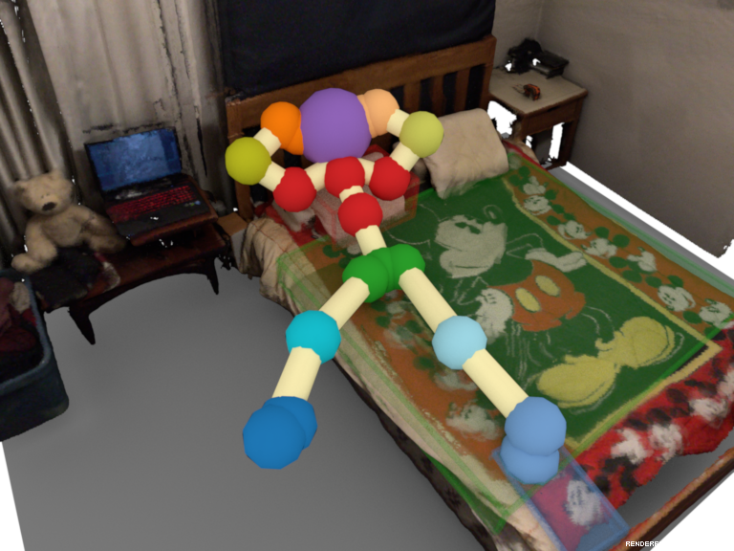
Data
30 rooms: offices, living rooms, bedrooms, …
63 videos of 5 people (~2 hrs, ~300 action observations)
Interaction labels: verb-noun pairs
sit-chair & look-monitor & type-keyboard
stand-floor
& write-whiteboard
lie-bed
Interactions in 13 verb classes: look, sit, stand, write, lean, lie, grasp, read, type, touch, switch, use, “rest feet”

Slide 15
Observation
Learning
Generation

Slide 16
Observation
Learning
Generation

Slide 17
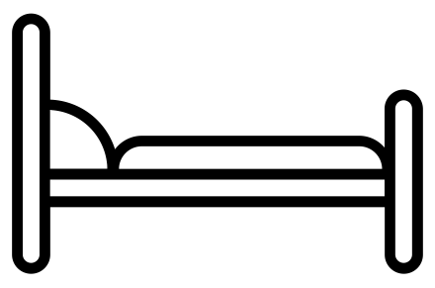
Representing interactions
pose

Slide 18
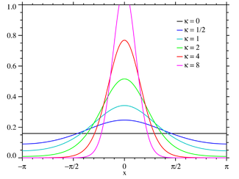


Pose priors
Joint $j∈ℝ^{3}$
latitude-longitude-roll
von Mises distributions
Pose $p∈ℝ^{2⋅3⋅25}=ℝ^{150}$
[Image copyright user PAR, https://en.wikipedia.org/wiki/Von_Mises_distribution#/media/File:VonMises_distribution_PDF.png]

Slide 19
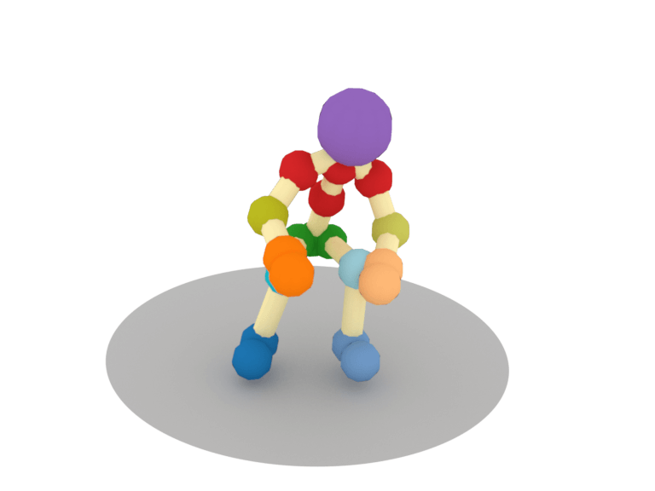
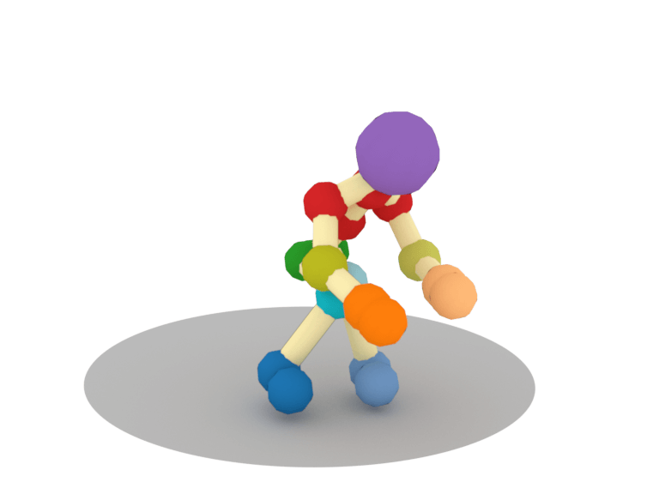
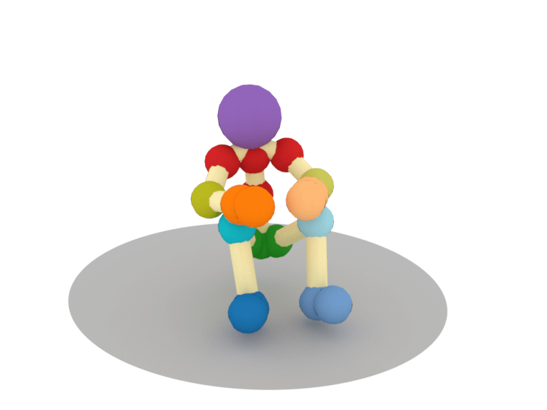
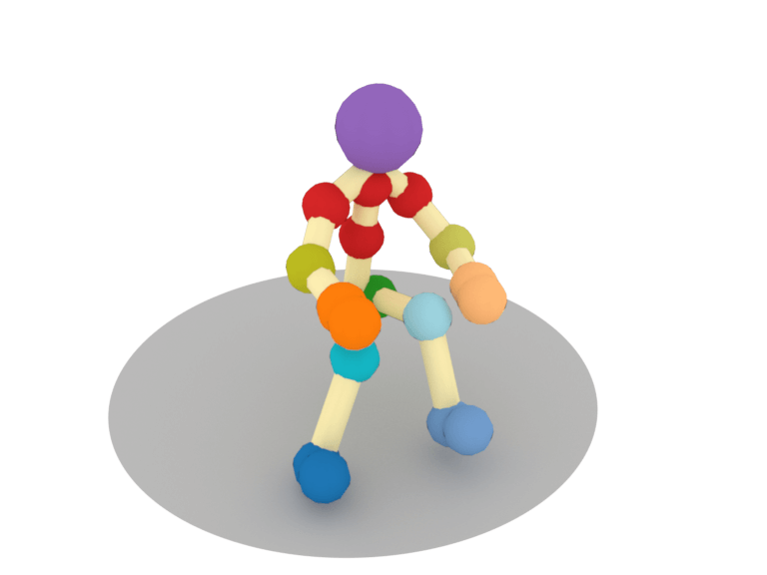
Average poses
sit
type
read
look

Slide 20
Representing interactions
pose-object

Slide 21
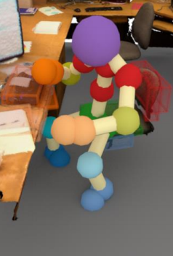
Learning
sit-chair & look-monitor & type-keyboard
monitor
gaze
torso
backrest
hands
hips
seat
key- board
feet
floor

Slide 22
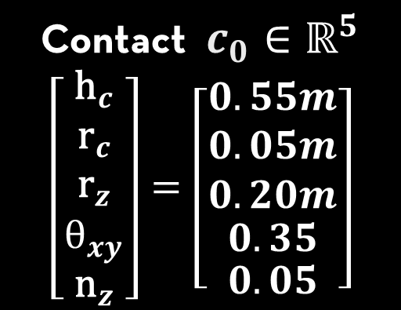







Learning
Segment $S_{0}∈ℝ^{5}$
$$\left[\begin{aligned}\begin{aligned}\begin{matrix}{\text{p}}_{z} \\ {\text{h}}_{z} \\ {\text{d}}_{xy}\end{matrix} \\ {\text{a}}_{xy}\end{aligned} \\ {\text{n}}_{z}\end{aligned}\right]=\left[\begin{aligned}\begin{aligned}\begin{matrix}0.60m \\ 0.25m \\ 0.50m\end{matrix} \\ 0.05m\end{aligned} \\ 0.05\end{aligned}\right]$$
$${\text{d}}_{xy}$$
$${\text{h}}_{z}$$
$${\text{p}}_{z}$$
monitor
sit-chair & look-monitor & type-keyboard
torso
backrest
Contact $c_{0}∈ℝ^{5}$
$$\left[\begin{aligned}\begin{aligned}\begin{matrix}{\text{h}}_{c} \\ {\text{r}}_{c} \\ {\text{r}}_{z}\end{matrix} \\ θ_{xy}\end{aligned} \\ {\text{n}}_{z}\end{aligned}\right]=\left[\begin{aligned}\begin{aligned}\begin{matrix}0.55m \\ 0.05m \\ 0.20m\end{matrix} \\ 0.35\end{aligned} \\ 0.05\end{aligned}\right]$$
gaze
torso
backrest
$${\text{z}}_{c}$$
hands
hips
seat
$${\text{h}}_{c}$$
$${\text{r}}_{c}$$
Center of Mass
key- board
feet
floor

Slide 23

Learning
Segment $S_{0}∈ℝ^{5}$
$$\left[\begin{aligned}\begin{aligned}\begin{matrix}{\text{p}}_{z} \\ {\text{h}}_{z} \\ {\text{d}}_{xy}\end{matrix} \\ {\text{a}}_{xy}\end{aligned} \\ {\text{n}}_{z}\end{aligned}\right]=\left[\begin{aligned}\begin{aligned}\begin{matrix}0.60m \\ 0.25m \\ 0.50m\end{matrix} \\ 0.05m\end{aligned} \\ 0.05\end{aligned}\right]$$
monitor
sit-chair & look-monitor & type-keyboard
torso
backrest
Contact $c_{0}∈ℝ^{5}$
$$\left[\begin{aligned}\begin{aligned}\begin{matrix}{\text{h}}_{c} \\ {\text{r}}_{c} \\ {\text{r}}_{z}\end{matrix} \\ θ_{xy}\end{aligned} \\ {\text{n}}_{z}\end{aligned}\right]=\left[\begin{aligned}\begin{aligned}\begin{matrix}0.55m \\ 0.05m \\ 0.20m\end{matrix} \\ 0.35\end{aligned} \\ 0.05\end{aligned}\right]$$
gaze
torso
backrest
hands
hips
seat
key- board
feet
floor

Slide 24
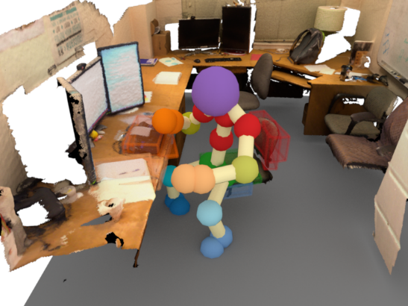
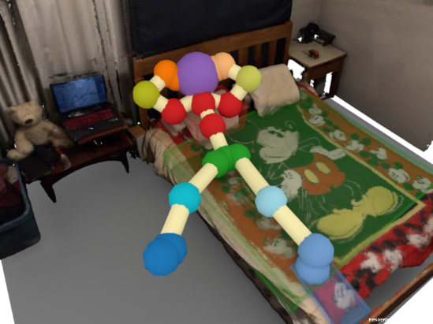



Learning
Segment
$$\left[\begin{aligned}\begin{aligned}\begin{matrix}{\text{p}}_{z} \\ {\text{h}}_{z} \\ {\text{d}}_{xy}\end{matrix} \\ {\text{a}}_{xy}\end{aligned} \\ {\text{n}}_{z}\end{aligned}\right]=\left[\begin{aligned} \\ \\ \\ \\ \end{aligned} \right]$$
…
monitor
sit-chair & look-monitor & type-keyboard
torso
backrest
Contact
$$\left[\begin{aligned}\begin{aligned}\begin{matrix}{\text{h}}_{c} \\ {\text{r}}_{c} \\ {\text{r}}_{z}\end{matrix} \\ θ_{xy}\end{aligned} \\ {\text{n}}_{z}\end{aligned}\right]=\left[\begin{aligned} \\ \\ \\ \\ \end{aligned} \right]$$
gaze
torso
backrest
hands
hips
seat
key- board
feet
floor

Slide 25




Learning
Segment
$$\left[\begin{aligned}\begin{aligned}\begin{matrix}{\text{p}}_{z} \\ {\text{h}}_{z} \\ {\text{d}}_{xy}\end{matrix} \\ {\text{a}}_{xy}\end{aligned} \\ {\text{n}}_{z}\end{aligned}\right]=\left[\begin{aligned} \\ \\ \\ \\ \end{aligned} \right]$$
Segment
$$\left[\begin{aligned}\begin{aligned}\begin{matrix}{\text{p}}_{z} \\ {\text{h}}_{z} \\ {\text{d}}_{xy}\end{matrix} \\ {\text{a}}_{xy}\end{aligned} \\ {\text{n}}_{z}\end{aligned}\right]=\left[\begin{aligned} \\ \\ \\ \\ \end{aligned} \right]$$
sit-chair & look-monitor & type-keyboard
Contact
$$\left[\begin{aligned}\begin{aligned}\begin{matrix}{\text{h}}_{c} \\ {\text{r}}_{c} \\ {\text{r}}_{z}\end{matrix} \\ θ_{xy}\end{aligned} \\ {\text{n}}_{z}\end{aligned}\right]=\left[\begin{aligned} \\ \\ \\ \\ \end{aligned} \right]$$
monitor
Gaze
$$\left[\begin{aligned}\begin{aligned}\begin{matrix}{\text{h}}_{c} \\ {\text{r}}_{c} \\ {\text{r}}_{z}\end{matrix} \\ θ_{xy}\end{aligned} \\ {\text{n}}_{z}\end{aligned}\right]=\left[\begin{aligned} \\ \\ \\ \\ \end{aligned} \right]$$
gaze
torso
backrest
…
hands
hips
seat
…
…
…
key- board
feet
floor
…
…

Slide 26
What are we learning?
Segment
$$\left[\begin{aligned}\begin{aligned}\begin{matrix}{\text{p}}_{z} \\ {\text{h}}_{z} \\ {\text{d}}_{xy}\end{matrix} \\ {\text{a}}_{xy}\end{aligned} \\ {\text{n}}_{z}\end{aligned}\right]=\left[\begin{aligned} \\ \\ \\ \\ \end{aligned} \right]$$
Segment
$$\left[\begin{aligned}\begin{aligned}\begin{matrix}{\text{p}}_{z} \\ {\text{h}}_{z} \\ {\text{d}}_{xy}\end{matrix} \\ {\text{a}}_{xy}\end{aligned} \\ {\text{n}}_{z}\end{aligned}\right]=\left[\begin{aligned} \\ \\ \\ \\ \end{aligned} \right]$$
sit-chair + look-monitor + type-keyboard
Contact
$$\left[\begin{aligned}\begin{aligned}\begin{matrix}{\text{h}}_{c} \\ {\text{r}}_{c} \\ {\text{r}}_{z}\end{matrix} \\ θ_{xy}\end{aligned} \\ {\text{n}}_{z}\end{aligned}\right]=\left[\begin{aligned} \\ \\ \\ \\ \end{aligned} \right]$$
monitor
Gaze
$$\left[\begin{aligned}\begin{aligned}\begin{matrix}{\text{h}}_{c} \\ {\text{r}}_{c} \\ {\text{r}}_{z}\end{matrix} \\ θ_{xy}\end{aligned} \\ {\text{n}}_{z}\end{aligned}\right]=\left[\begin{aligned} \\ \\ \\ \\ \end{aligned} \right]$$
gaze
torso
backrest
…
hands
hips
seat
…
…
…
key- board
feet
floor
…
…

Slide 27
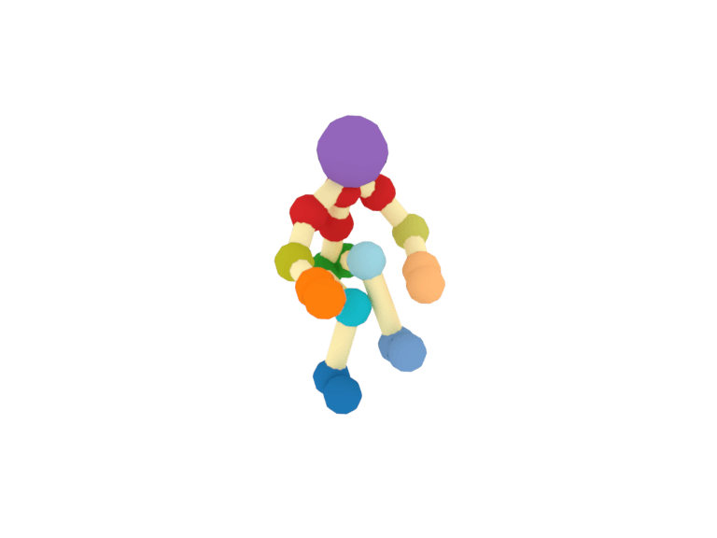
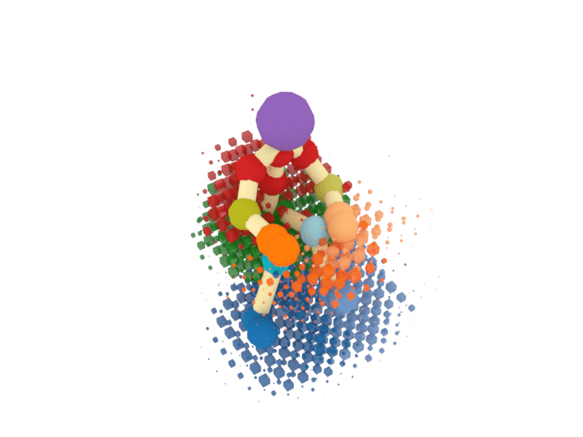
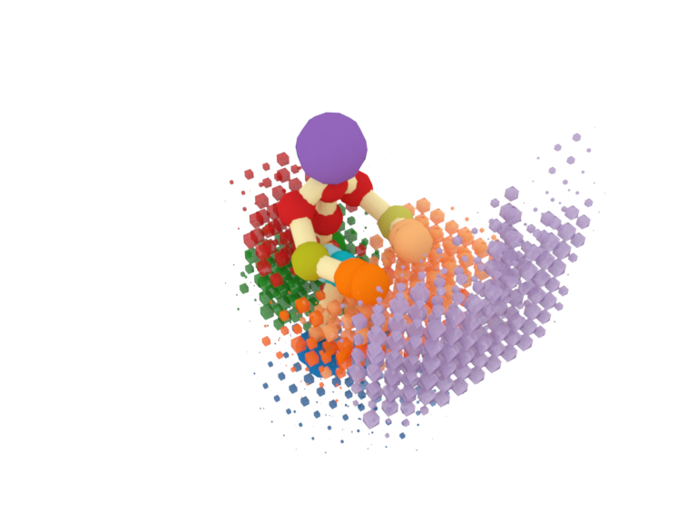
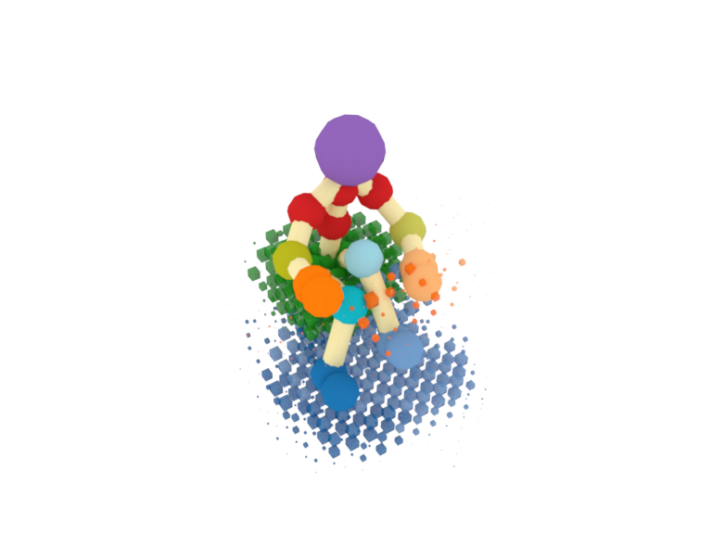
Interaction between body parts and object parts
sit-stool
sit-chair
sit-chair & look-monitor & type-keyboard

Slide 28
Observation
Learning
Generation

Slide 29
Observation
Learning
Generation

Slide 30
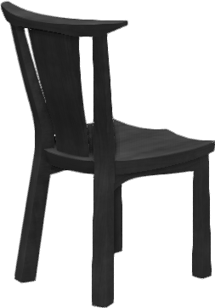
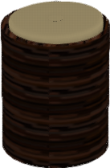

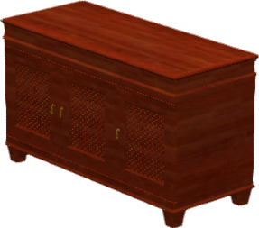
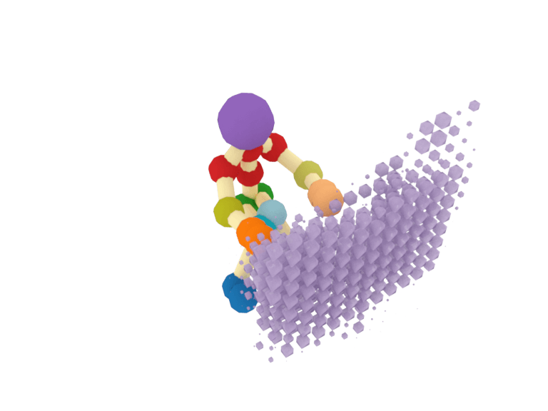
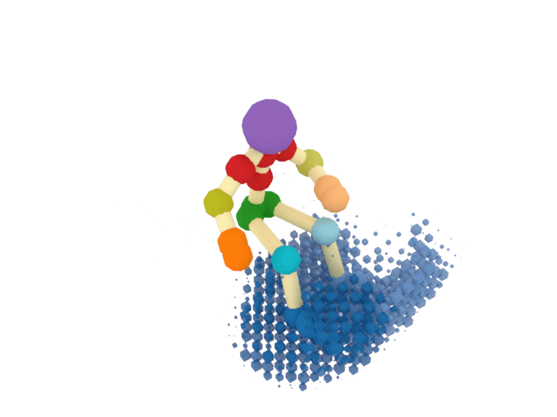
Generation
Iterative posing
look-TV & “rest feet”-stool
3D model retrieval
0
gaze
TV
Pose sampling
1
hands
torso
TV stand
hips
feet
2
chair
stool
Infer interactions
3
Body part support and interactions

Slide 31

Generation
Iterative posing
watch-TV + “rest feet”-stool
3D model retrieval
0
Snapshot score given pose $J$ and model set $M$
gaze
TV
Pose sampling
1
hands
torso
TV stand
$$L_{A}\left(J,M\right)=w_{p}{L_{p}}_{A}\left(J\right)+w_{o}L_{o}\left(M\right)+w_{i}L_{i_{A}}(J,M)$$
hips
feet
pose
object
interaction
2
chair
stool
Infer interactions
3
Body part support and interactions

Slide 32
Generation
look-TV & “rest feet”-stool

Slide 33
Generated snapshots
lie-bed
sit-bed & use-laptop
sit-chair & use-laptop
look-whiteboard

Slide 34
Generated snapshots
lie-bed
sit-bed & use-laptop
Are all the parts of the model useful?
sit-chair & use-laptop
look-whiteboard

Slide 35
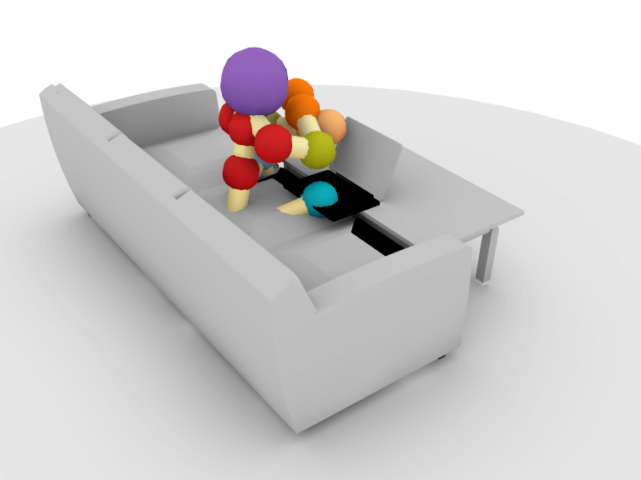
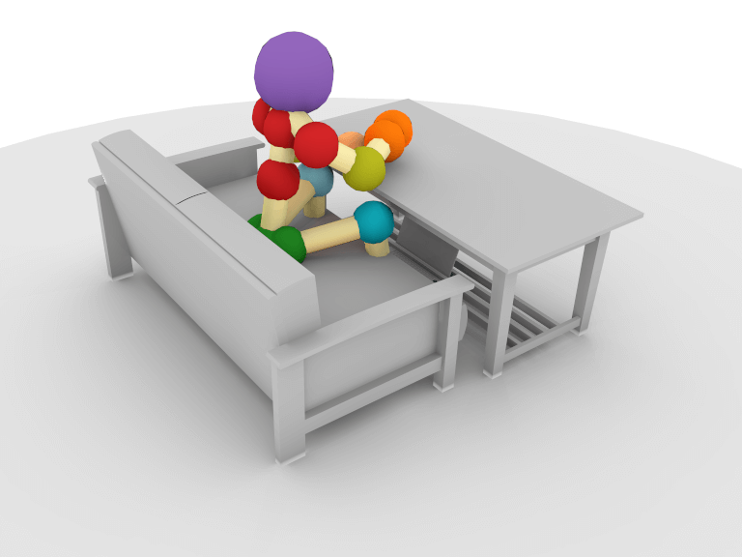
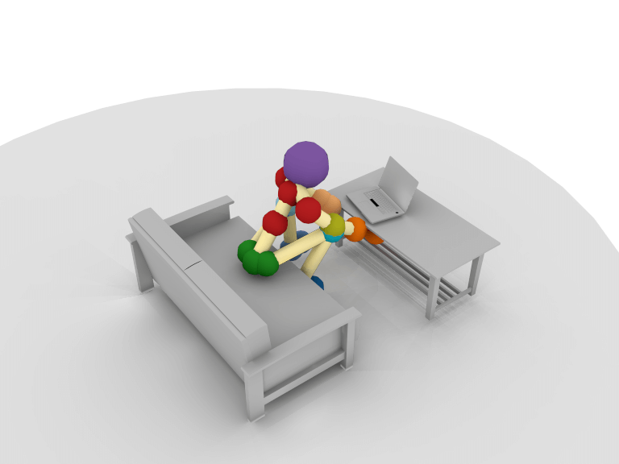
Evaluation
sit-couch & use-laptop
Fixed positioning
Average pose
Priors for positioning
Average pose
Priors for positioning
Optimized pose
Average = 3.09
Average = 3.79
Average = 3.92

Slide 36
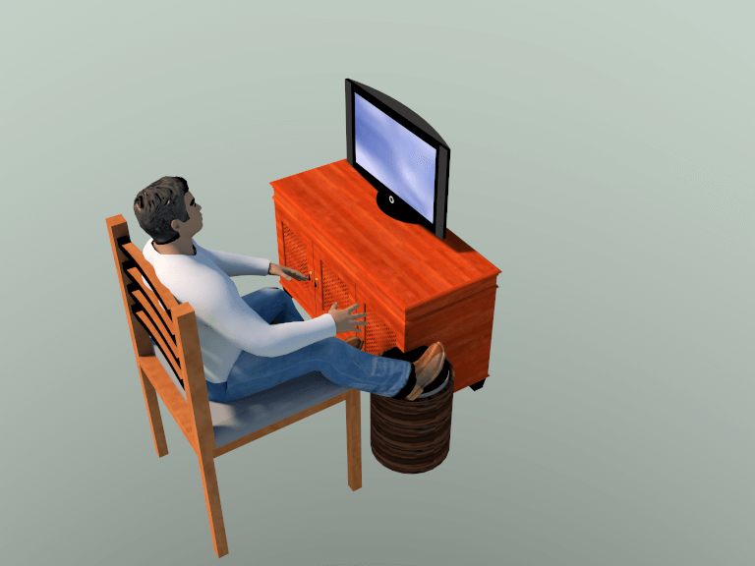
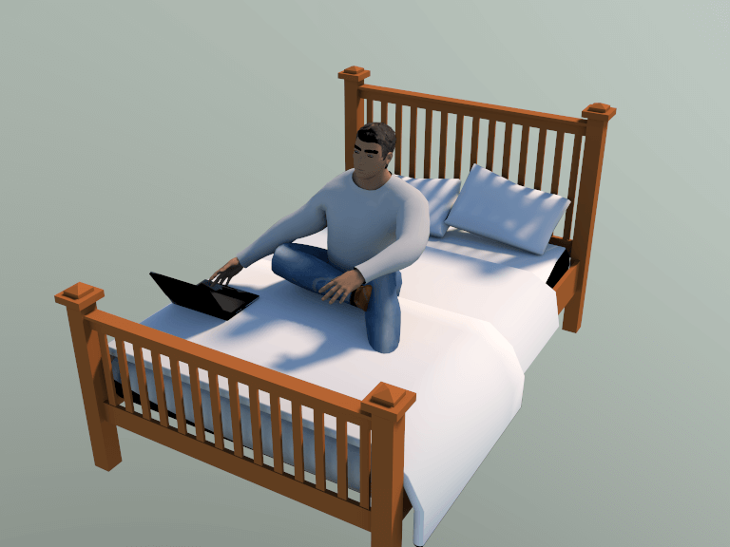
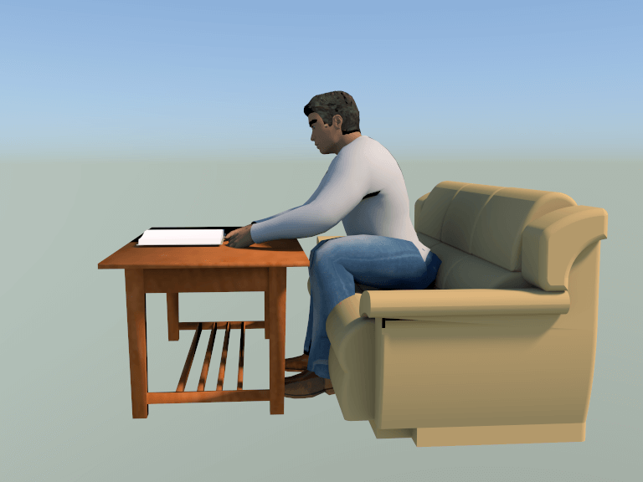
“Text to interaction”
He is watching TV and resting his feet on a stool
He is sitting on the bed and using a laptop
He is sitting on the couch and reading a book

Slide 37


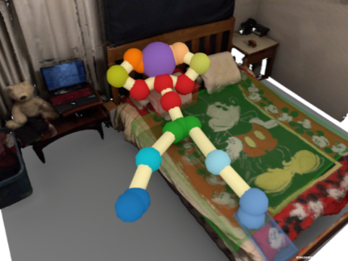
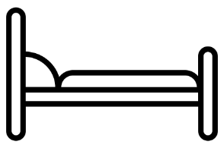
Summary
+
…

Slide 38
Summary
Watch TV
+
…

Slide 39
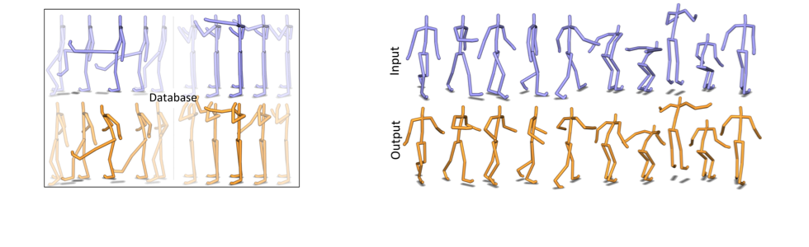


Future work
More actions and objects
Social interactions
Dynamic activities
[Lee et al. 2006]
[Liu et al. 2016]
[Yumer and Mitra 2016]
[Min and Chai 2012]
[Agrawal and van de Panne 2016]
[Holden et al. 2016]
[Image copyright EA Maxis / Electronic Arts Inc., https://www.thesims.com/news/sims-4-dine-out-news]

Slide 40













Thank you!
Details, code and data at
http://bit.ly/pigraphs
PiGraphs: Learning Interaction Snapshots from Observations Manolis Savva, Angel X. Chang, Pat Hanrahan, Matthew Fisher, Matthias Nießner

